Slide 1

Avionics Bay Pressure Transducer Preliminary Design Review (In progress)
Sam Vineyard
Avionics

Slide 2
Requirements
For Avionics Bay:
high accuracy low pressure sensing on order of ~ 0.2 psia
IC breakout board available for prototyping/testing
termination style compatible with PCB
digital output read by microcontroller
cost: < $20
power efficient: < tens of mA

Slide 3
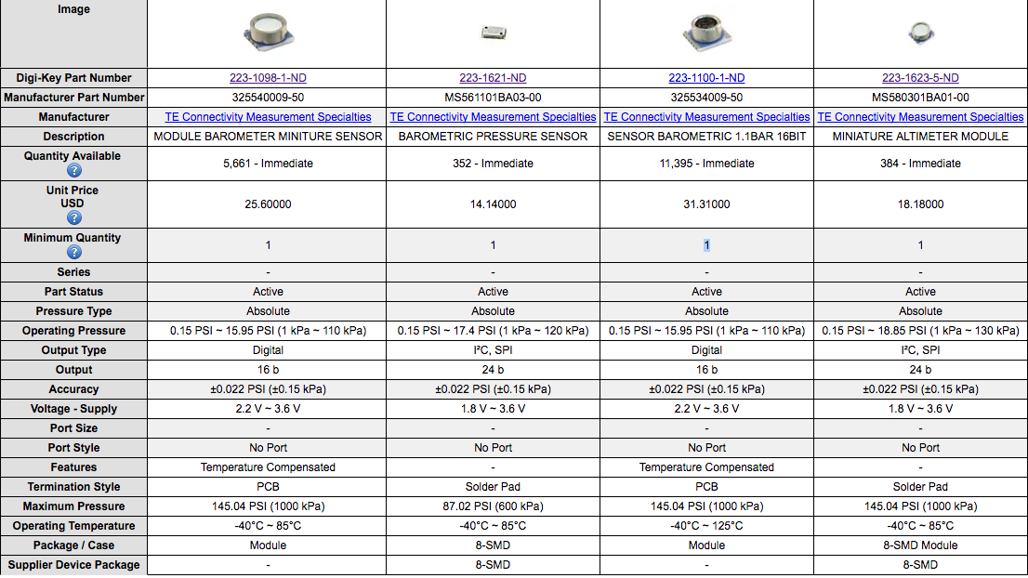
Avionics Bay Pressure Transducer Trade Study
Notes:
=

Slide 4



Visual Comparison of Pressure Transducers
+/-
PSIA
PSIA
$
Operating Pressure
Notes:
=

Slide 5

Choice of Pressure Transducer
MS5611-01BA03
Most cost-effective solution at $14.14
Identical in low end of operating pressure range (0.15 PSIA) as other options
Identical accuracy (+/- 0.022 PSIA) as other options
Solder pads for surface mounting
I2C/SPI protocol capabilities
Extremely low current draw ~ 1 uA
Notes:
=

Slide 6
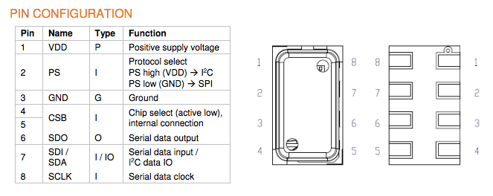
Pin Configuration of MS5611-01BA03
Figure 1: High level pin-out view
For I2C protocol, pins 5 and 6 for SDO will be unused (NC)
Complement of CSB pin represents LSB of I2C address
Notes:
=

Slide 7
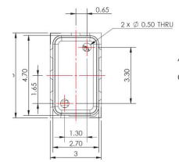
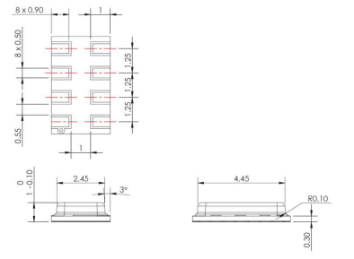
Package Dimensions MS5611-01BA03
All dimensions in MM
General tolerance +/- 0.05
Figure 1: Package Dimensions
Notes:
=

Slide 8
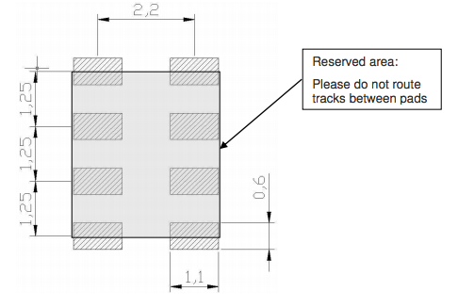
Pad Layout MS5611-01BA03
Reserved area is for placement of silkscreen (seen on following slide for PCB footprint)
All dimensions in MM
Figure 1: Pad Layout
Notes:
=

Slide 9
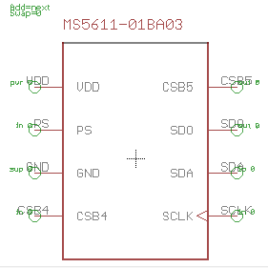
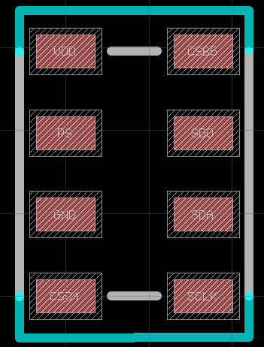
PCB Design MS5611-01BA03
All designs done in Eagle CAD, adhering to datasheet specs for package dimensioning and pad layout for footprint
Physical package
dimension (blue)
Silkscreen (gray)
Figure 1: Symbol schematic
Figure 2: Package/Footprint
Notes:
=

Slide 10
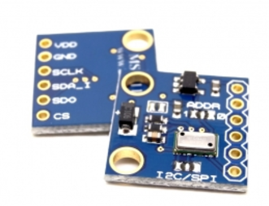
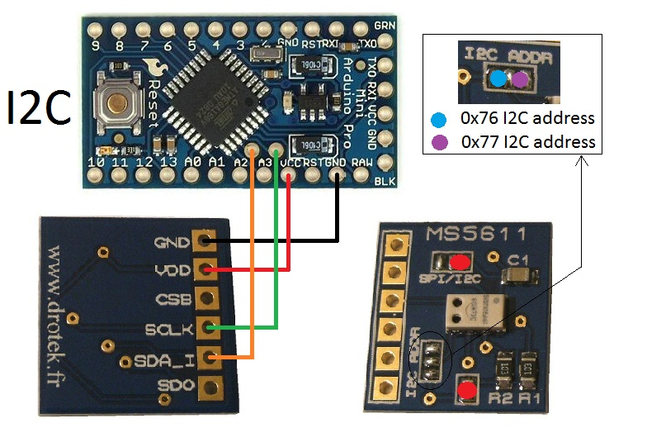
Breakout Board MS5611-01BA03
Breakout board primarily used for prototyping and testing
Data read to Arduino microcontroller for processing
Figure 1: Example I2C connection of
breakout board to Arduino Mini
Notes:
=

Slide 11
Appendix A: Reference Documents
MS5611-01BA03 datasheet
Http://www.digikey.com/product-detail/en/te-connectivity-measurement-specialties/MS561101BA03-00/223-1621-ND/5277498
MS5611-01BA03 breakout board for prototyping
https://drotek.com/shop/en/home/44-ms5611-pressure-barometric-board.html
MS5611-01BA03 example code on github
https://github.com/jarzebski/Arduino-MS5611

